Slide 1
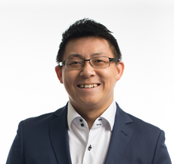
ABOUT ME
About Me
Arthur Ma
EXPERIENCE
General Manager
Markwise Plastics Inc
1
EDUCATION
Hons. B.A. Economics
University of Toronto
Director, Corporate Strategy
Sears Canada
2
Divisional Merchandise Manager
Menswear, Sears Canada
3
MBA, Queen’s (Smith)
School of Business
3
4
Director, Merchandising
Menswear, Basics, Loungewear
Target Canada
RETAILERS
INTERESTS
Target Canada
Product Management
Grainger Canada
5
Spending time with family
Sears Canada
Entrepreneurship
Loblaws Companies
Founder & CEO
Wingmen Suits Inc.
6
Loves to travel
West 49
Basketball, Golf

